Slide 1
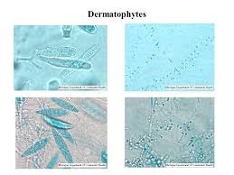
Dermatophytes
Dr. Bincy Joseph
Assistant Professor
PGIVER, Jaipur

Slide 2
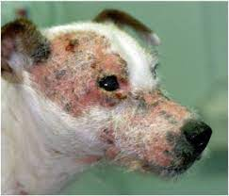
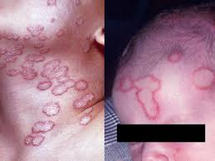
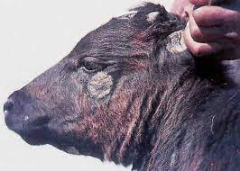
mycoses
Diseases caused by fungi is called mycoses
Disease are three types based on the tissues affected
Superficial mycoses/ Dermatomycoses
S/c or Intermediary mycoses
Deep / visceral or systemic mycoses

Slide 3
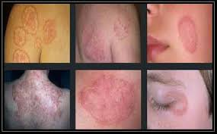
Sperficial mycoses- Dermatophytosis
Caused by Dermatophytes
Generally known as ring worm fungi.
This require keratin for their growth and affect stratum corneum of skin hair nail etc

Slide 4
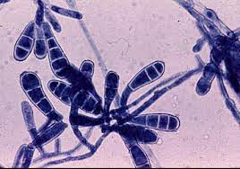
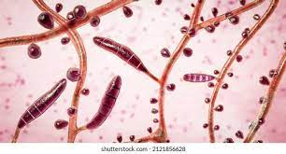
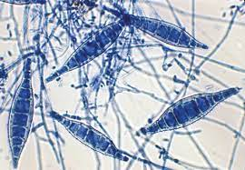
classification
There are three important genera
Trichophyton
Microsporon
Epidermophyton
This organism are classified under Ascomycetes
Epidermophyton
Trichophyton
Microsporon

Slide 5
Classification
Based on tropism dermatophytes are classified as
Zoophilic- present in animals
Microsporon canis and Trichophyton verrucosum
Geophilic : Natural habitat is soil
M. gypseum, M. nanum, T. simii
Anthropophilic: Primarily infect human being
T. rubrum, Epidermophyton floccosum

Slide 6
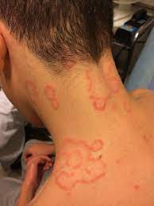
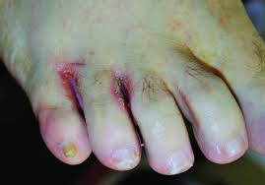
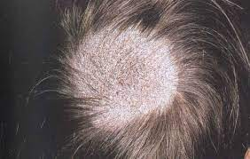
The disease produced by Trichophyton and Microsporon in human being is called Tinea
Both Microsporon and Trichophyton produce disease in animals and human being
Trichophyton will affect skin, hair and nail
Microsporum will affect skin and hair
Epidermophyton affects nail and skin
Tinea corporis
Tinea pedis
Tinea capitis

Slide 7
Important species are
Trichophyton | Microsporon | Epidermophyton
T. verrucosum, T. equinum T. violaceum T. mentagrophytes T. schoenlenii T. gallinae T. simii | M. nanum M. distortum M. gypseum M.canis M. audouini M. gallinae | Epidrmophyton floccosum

Slide 8
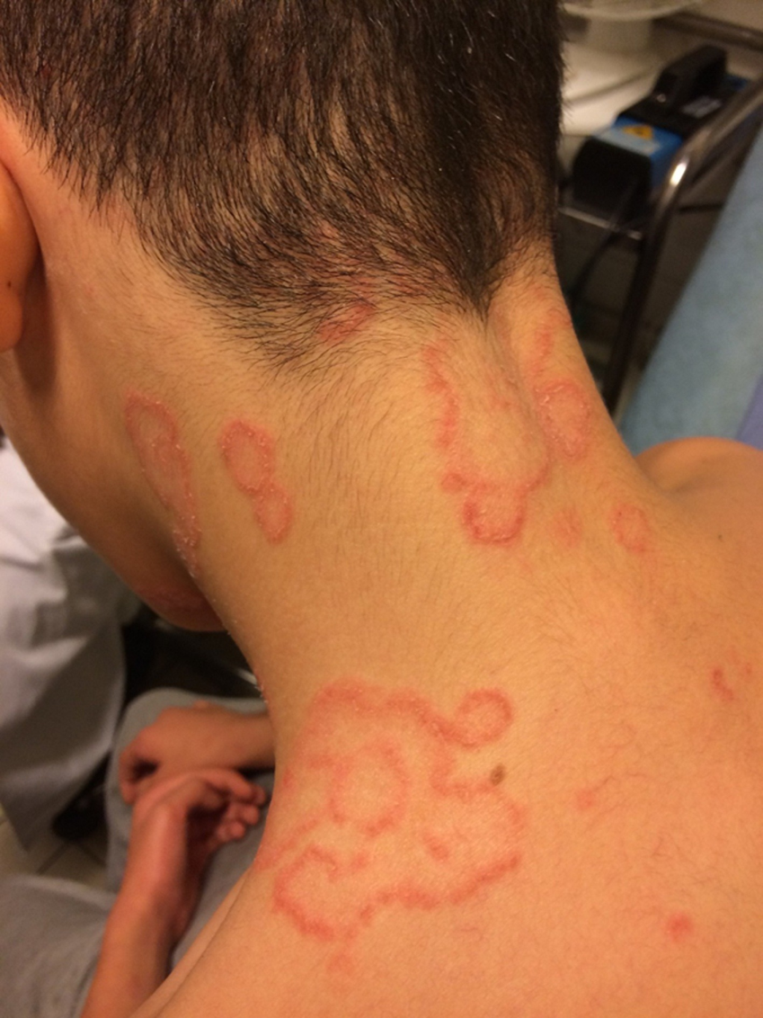
pathogenesis
These organism cause hydrolysis of keratin
As a result of infection the host mount inflammatory response
Organism can not thrive in an area of intense infection and will move to periphery so it will produce ring like lesions
Central area will have healed appearance with inflammed periphery
Lesions are produced by toxins, allergens and enzymes like keratinase and collaginase

Slide 9
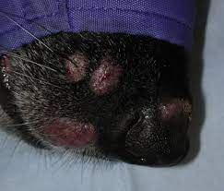
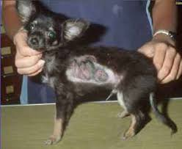
Clinical forms
Subclinical
Classical ring worm
Generalised form
Kerion / tumor like lesions in dogs

Slide 10
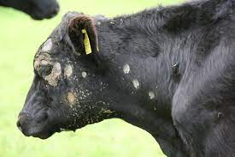
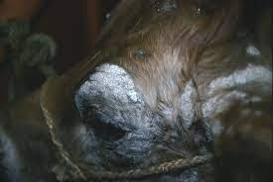
Clinical signs
In dogs and cat important organism is Microsporon canis
Main lesion occur in face and extremity
It will produce crusty alopecia lesion
In cattle important organism is Trichphyton verrucosum and T. mentagrophytes
Lesions mainly in face and neck region
Extent of lesion may vary it can be mild infection characterised by eruption and alopecia
Chronic lesions are yellowish brown, very thick asbestose like appearance of skin

Slide 11
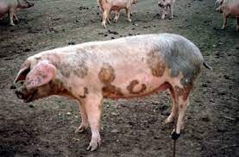
In horse Trichopyton equinum and Trichophyton mentagrophytes
lesions are seen in withers, saddle and girth with either urticarial eruption or deep ulcerative nodule
In sheep and goat organism are Trichophyton verrucosum and T. mentagrophytes
In pigs T. verrucosum, T. mentagrophytes, M.nanum
In pig urticarial lesion on the base of ear and trunk

Slide 12
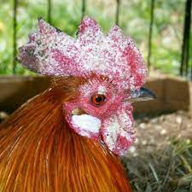
In poultry T. gallinae, M.galline
Disease is known as avian ring worm or favus
Disease seen as white patchy crust on comb and wattle

Slide 13
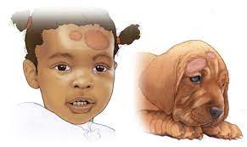
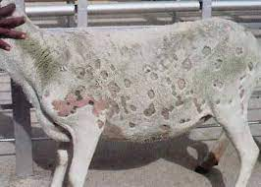
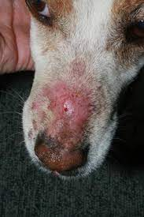
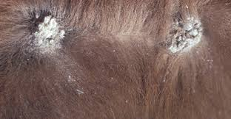
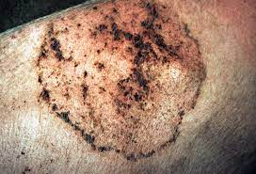
Diagnosis
Symptoms and lesions
Ring worm appearance

Slide 14
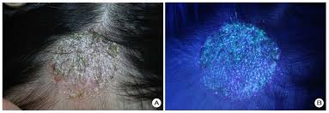
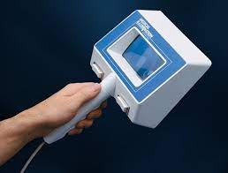
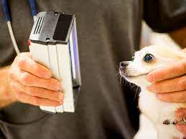
Wood lamp test
Examination of infected hair using Wood’s lamp or UV lamp
If infected hair is shown on wood lamp, there will be apple green flourescence due to the production of metabolite of Tryptophan by the organism
Positive in infection by M. canis, M. distortum and M. audonii
False positive with dandruff or application of salicylic acid or petroleum jelly

Slide 15
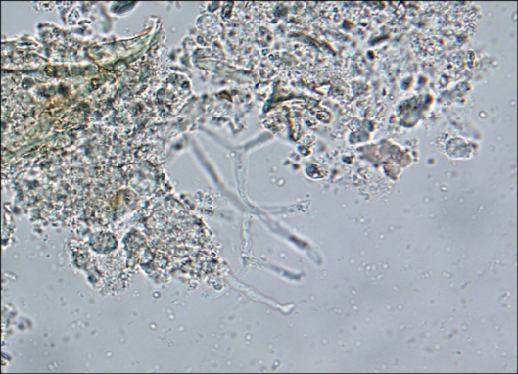
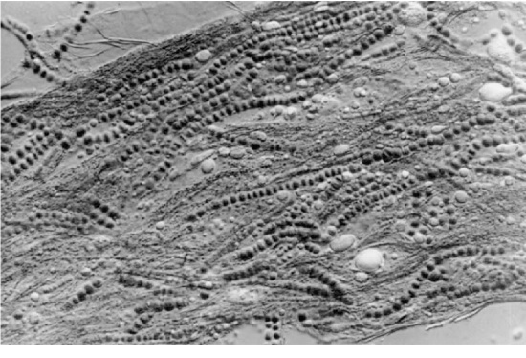
Direct microscopical examination of skin scrapping or hair
Before collection of these , clean the area with 70% alcohol. Scrape skin from old and new lesions with blunt scalpel or razor blade untill blood oozes to come out
Better to pluck hair
Take skin scarpping or hair on a clean slide and add 2-3 drop of 10-20 % KOH ( Keratolytic)
Gently warm the slide at 60ºC for 5-1 minutes
Put coverslip and examine under low and high power
KOH cause partial digstion of Keratin leading to clearing of specimen

Slide 16
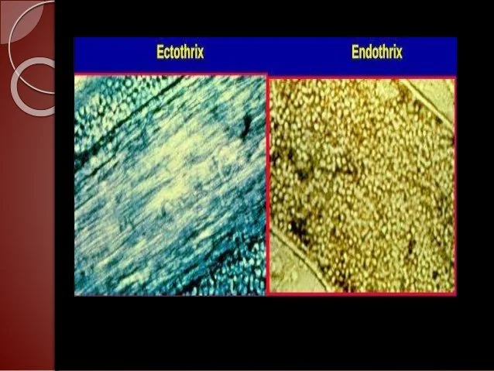
Most fungal agents of animals, spores can seen on external surface of hair and such arrangement called ectothrix
M. canis, T. verrucosum, T. mentagrophytes
In some other case large spore arranged lineraly within hair shaft called endothrix
T. violaceum
T. schoenleinii along with spore large number of air bubbles also seen
T. gallinae, T, simii, T,rubrum will not affect hair

Slide 17
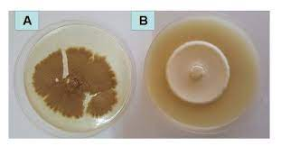
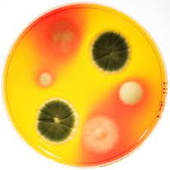
Isolation and identification
Before isolation hair should be dipped in 70% alcohol for 2-3 minutes to decrease bacterial load
After this point inoculation is done on SDA supplemented with chloramphaenicol @ 50 ug/ml and cycloheximide @ 500 mg/ml
Chloramphenicol inhibhit bacterial growth and cycloheximide inhibhit saprophytic fungal organism
In Dermatophyte test medium ( DTM) where phenol red is indicator Growth of dermatophyte result in alkaline metabolic products and the colour of the medium will change to red
After inoculation with any medium, border of the petridish should be sealed with cellotape film to prevent dessication
As fungi are aerobic we have to open the petridish daily
Incubation at 25-30ºC

Slide 18
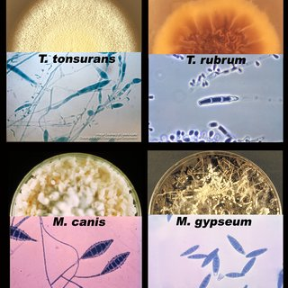
Trichophyton mentagrophytes and Trichophyton verrucosum grow well at 37ºC
Fairly rapid growth seen in Microsporon canis and growth within 4-6 days
T. verrucosum takes 5 weeks for growth

Slide 19
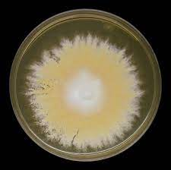
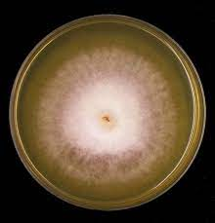
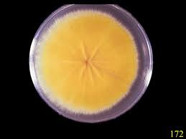
Identification of Dermatophytes
Identificationis based on colony and microscopic morphology
Usually fungal growth is irregular and spreading type in initial stage
M. audoinii- colony velvetty type
M. gypseum colony powdery type
M. canis the colony is silky and lemon yellow colored

Slide 20
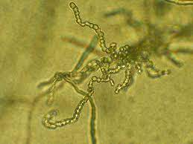
Some organism produce soluble pigment in the medium
M. canis lemon yellow pigment
M. rubrum red pigment
Later identification based on conidia and hyphae
For T. verrucosum large number of chlamydospores seen in long chains
Trichophyton and Microsporon can be differentiated based on microconidia and macroconidia
In Trichophyton macroconidia rare and are cigar shaped, thin walled containing 3-8 cells
In Microsporon macroconidia are spindle shaped thick walled containing many cells

Slide 21
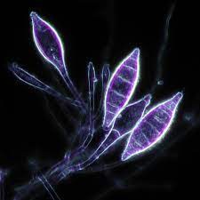
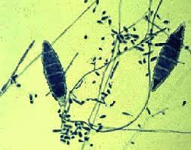
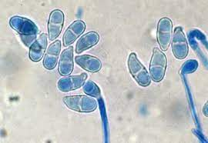
In Trichophyton microconidia are numerous arranged singly or in bunches
In microsporon microconidia are less in number pear like and arranged along hyphae
M. canis: spindle shaped macroconidia thick walled upto 15 septa
M. gypseum : boat shaped, thin walled and upto 16 septa
Microsporon nanum pear shaped or ovoid macroconidium,thin walled, single septum

Slide 22
Hair perforation or hair penetration test
In this collect sterile hair from a child. This hair is placed on culture of dermatophytes under investigation. Incubate at 25ºC and stain with lactophenol cotton blue
Examine microscopically from 7th day onwards
If dermatophytes is Trichophyton mentagrophytes, M. canis, they penetrate hair shaft forming wedge shaped dark blue structure

Slide 23
Treatment
Different groups of agents like irritant, keratolytic agent, fungicide, fungistatic agent are common agent used
These are applied as ointment or powder or used through oral route
Some of the antifungal agents are Tincture I₂, Whiefield ointment, candid powder,mycoderm powder, Nystatin both cream and powder
Oral preparation
Griseofulvin, Ketoconazole, Itraconazole, In chronic cases the best drug is castellani’s paint

Slide 24
PREVENTION
Maintenance of hygiene in animal shed
In cat adjuvanted vaccine available
Attenuated vaccine available for control of T. verrucosum

Slide 25
Histological sections of skin or pseudomycetomas can be stained by the PAS or methenamine
silver techniques to demonstrate fungal structures.
Lactophenol cotton blue staining

Slide 26
Dermatophytosis in cats and dogs
Microsporon canis
Clinical features of the disease include classical
ringworm lesions, miliary dermatitis, pseudomycetomas
lime sulphur or miconazole shampoo may be effective
Itraconazole, fluconazole or terbinafine, administered orally, are the drugs of choice for systemic therapy

Slide 27
Dermatophytosis in cattle
Trichophyton verrucosum
Commercial vaccines containing an attenuated strain of T. verrucosum (LTF-130 or CCM 8165) have been used successfully for the control of bovine dermato- phytosis in Europe and Russia

Slide 28
Dermatophytosis in horses byTrichophyton equinum
Dermatophytosis in pigs by M. nanum.

Slide 29
Favus in poultry
M. gallinae
White patchy crusts develop on the comb and wattles.

Slide 30
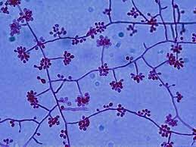
Subcutaneous mycoses:Sporotrichosis
By Sporothrix schenckii, a dimophic fungi (ie, at 37ºC yeast form and at 30ºC mycelial form
The organism occur as saprophyte and infection occur as wound infection
It is seen in tropical and subtropical region

Slide 31
Disease
Two form
Involvement of subcutaneous tissue and lymphatic
Disseminated infection and is commonly seen in dog
It is an important disease in horse with 2 forms
Nodules are seen in s/c tissue which later ulcerate discharging pus
Other form is called ulcerative lymphangitis, where lymph vessels are affected.

Slide 32
Macroscopically lesions are granulomatous but microscopically numerous spherical or oval yeast cells called as cigar bodies present in the granuloma
Around cigar bodies asteroid rays are seen which are eosinophilic material arranged in a stellate fashion

Slide 33
Diagnosis
Direct microscopical examination of pus or exudate from lesions
Gram staining
These are Gram positive spherical or oval elongated yeast cells.
Histopathology
PAS –periodic acid schiff agent or by FAT
Isolation and identification of organism
Pus or exudate is inoculated on Sabouraud’s dextrose agar with chloramphenicol and cycloheximide
Instead of SDA, also can use blood agar or brain heart infusion agar

Slide 34
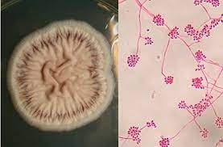
Inoculate on 2 petridish
One at 37ºC and other at 25ºC and incubate
At 37ºC growth within 5 days and colonies are smooth, soft, cream to tan in colour (yeast form)
At 25ºC mycelial form grow and growth occur within a week time.
Initially colonies are white in colour, but later become black or brown due to spore formation
Examination of mycelium demonstrate fine branched septate hyphae with numerous microconidia arranged in clusters as pistles of flower

Slide 35
Biological: pus/exudate inoculate intraperitoneally to mice. Sacrifice after 2 week and peritoneal exudate examined for yeast form
Serological test: CFT, agglutination test, latex agglutination, agar gel precipitation test
Sporotrichosis should be differentiated from epizootic lymphangitis (African farcy) by Histoplasma farciminosum and equine farcy by Barkhoderia mallei

Slide 36
Mycetoma/ Fungal tumour
A chronic granulomatous lesion discharging pus with granules caused Actinomycetes and higher fungi
If by actinomycetes it is known as actinomycotic mycetoma
If it is by true or higher fungi, it is called eumycotic mycetoma
Mycetoma in human being also called actinomycotic mycetoma caused by
Actinomycetes madurai
Actinomycetes israelli
Nocardia caviae
Nocardia farcinica

Slide 37
Emycotic mycetoma by
Allescheria boydii
Curvularia geniculata
Monosporium apiospermum
Helminthosporium species

Slide 38
Diagnosis
Direct microscopic examination of pus containing granules
In actinomycotic mycetoma large sulphur granules
In Eumucotic mycetoma granules are small irregular brown or black
When this granules are are examined microscopically, in Actinomycotic mycetoma thin hyphae of 0.5-1μm and in case of eumycotic mycetoma hyphae are long intertwined with 2-5μm and large number of chlamydospores

Slide 39
Rhinosporidium seeberi
Rhinosporidium seeberi is a fungus-like organism which has not been cultured on inert media but has been maintained in monolayers of human rectal tumour cells
Rhinosporidiosis, a sporadic, non-contagious, pyogranulomatous infection of the skin or mucosa, has been recorded in horses, dogs, cattle, goats, waterfowl and humans.
Cases occur predominantly in tropical and subtropical regions, particularly in Sri Lanka, southern India and Argentina

Slide 40
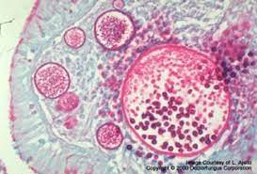
It is generally considered that stagnant water and possibly soil are the natural habitats of the organism
Rhinosporidium seeberi is of low pathogenic potential and disseminated infection is rare
The life cycle of the organism is uncertain
Rhinosporidiosis presents most commonly as a chronic polypous rhinitis characterized by the presence of large sporangia (100 to 400 μm in diameter) in affected tissues
The sporangia, which have double-contoured cell walls with an outer chitinous layer and an inner layer of cellulose, contain up to 16,000 endospores (approximately 7 μm in diameter)
Mature endospores can be stained by the PAS and methenamine silver methods
Several electron-dense bodies (1.5 to 2.0μm in diameter) containing DNA are present in the endospores

Slide 41
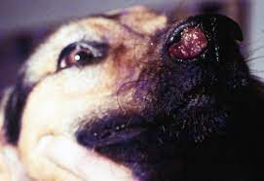
The polyps, which may be sessile or pedunculated and up to 3cm in diameter, are composed of soft fibromyxomatous stromal tissue covered by epithelium
Mature sporangia may be detectable grossly
in the stroma as minute white spots
Cellular response to sporangia is sparse except when they rupture.
The release of endospores elicits a marked pyogranulomatous reaction

Slide 42
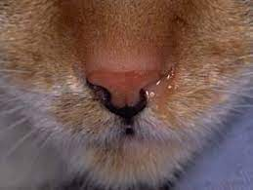
The reddish brown polyps in rhinosporidiosis may project from the nares and can occlude the nasal passages
Noisy breathing may be exacerbated by exercise
Nasal discharge is usually present and epistaxis may occur.
cryosurgery or electrocauterization is suggested to avoid excessive bleeding
Diaminodiphenylsulphone(dapsone)

Slide 43
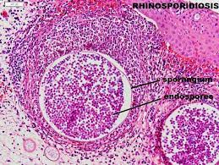
Diagnosis
Nasal polyposis may suggest the presence of the condition.
Specimens for laboratory examination should include biopsy material and scrapings from lesions.
Cytological examination demonstrates a neutrophilic response and many endospores.
Neutrophils form aggregates around endospores.
Sporangia can be demonstrated histologically in tissue sections.

Slide 44
Systemic mycoses- Zygomycoses
Caused by organism belonging to the class zygomycetes and order mucorales
So this disease also known as mucor mycosis
This fungi are commonly known as pin molds or bread molds because their dark sporangia resemble to pin heads and they are often found growin on stale bread
The organism which are important to animals are rhizopus, mucor, absidia, rhizomucor and mortierella

Slide 45
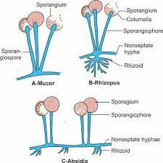

Slide 46
The organism are saprophytes and infection occur by ingestion and inhalation
Characteristic lesions are deep ulcers in stomach and intestine.
In pigs ulceration of mediastinal and submandibular lymph nodes is common
These organism are important causes of mycotic abortion in cattle
Abortion occur in late gestation and is often linked to mouldy hay or silage. The location of lesions on cotyledons suggest haematogenous infection of uterus.
Placenta has a woolen /thick appearance . Characteristic ring worm lesions are seen in fetus

Slide 47
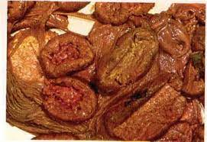
Organelles are enlarged
Inter cotyledonary area is thick and leathery in appearance

Slide 48
Diagnosis
Lactophenol cotton blue staining of clinical material
Clinical material include cotyledons, uterine tissue and fetal tissue, fetal stomach contents
On examination numerous broad non septate hypahe are seen
Demonstration of hyphae in tissue section by periodic acid schiff method
Gomori’s staining method and Gridley’s staining method
Demonstration in tissue by FAT

Slide 49
Isolation of organism on SDA, without cycloheximide because it is saprophytic fungi
Incubate aerobically at 37ºC for 5 days. Colonies are having a greyish wooly appearance
Growth is abundant, so the mycelia can raise the lid of petridish

Slide 50
Identification based on microscopic morphology
Hyphae are non septate, broad and sporangium are sac like structure with columella
Sporangiospores are seen in sporangium
The genus identification is possible by observing rhizoids which are root like structures
Rhizoids are seen in rhizopus, absidia, and mortierella
In mucor no rhizoids
In rhizopus sporangiophore arise just opposite to rhizoids
In absidia sporangiphore arise from a point away from rhizoid and sporangiophores are highly branching

Slide 51

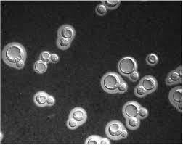
Cryptococcosis
Cryptococcus neoformans
Subacute or chronic disease of man and various species of animals involving CNS and respiratory system
Crytococcus neoformans can be isolated from droppings of pigeon and other birds and the soil enriched with these dropping.
Creatine presence in theses dropping is utilised by these yeast cells
They are round or oval and 3.5-8 umin diameter
A daughter cell is formed as a bud or narrow neck from the mother cell
Yeast cells have thick mucopolysacharide capsule which can be demonstrated in India ink preparations

Slide 52
The capsule can also be observed in tissue sections
It is an anaerobic non fermentative organism which form mucoid colonies on a variety of media including SDA
Ability to grow t 37ºC distinguishes Cryptococcus neoformans from other cryptococcus sp

Slide 53
Clinical signs
Apart from dog and cat, Cryptococcosis in animals rare
In companion animals, clinical signs relate to nasal cavity or skin involvement
Disease in dogs often disseminated with neurological and occular type
In horse include nasal granuloma, sinusitis, pneumonia menigoencephalitis and abortion
Cruptococcus neofrmans is an important cause of mastitis in cattle and menigitis in human

Slide 54
DIAGNOSIS
Clinical material include milk, CSF, urine,nasal discharge and exudate from skin lesions
DME after staining with India Ink reveals yeast cells with capsule
Cultivation : SDA or blood agar
incubate at 20oC or 37oC
Yeast colonies develop at both temperature
Littman Oxgall agar
Identification : based on mucoid colony
Demonstration of capsule
Urease test
Carbohydrate accumulation test
Growth on bird seed agar at 37oC
Latex agglutination test and FAT

Slide 55
treatment
Amphotericin B
Ketoconazole
Itraconazole
Fluconazole

Slide 56
THANK YOU

